Slide 1
Basic Electrical and Electronics Engineering
LECTURE 1.7
Dr. Sonam Shrivastava/ Assistant Professor (Sr.) /SELECT

Slide 2
BEEE102L
Basic Electrical and Electronics Engineering
DC Circuits
AC Circuits
Magnetic Circuits
Electrical Machines
Semiconductor Devices and Applications
Digital Systems

Slide 3
Books
Text Books
Allan R. Hambley, “Electrical Engineering -Principles & Applications”, 2019, 6th Edition, Pearson Education
V. D. Toro, Electrical Engineering Fundamentals, 2nd edition. PHI, 2014
Reference Books
R. L. Boylestad and L. Nashelsky, Electronic Devices and Circuit Theory, 11th edition. Pearson, 2012
DP Kothari & Nagrath, “Basic Electric Engineering”, 2019, Tata McGraw Hill

Slide 4
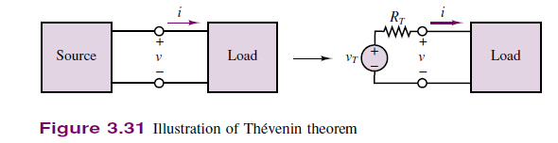
Thevenin’s Theorem
It often occurs in practice that a particular element in a circuit is variable (usually called the load) while other elements are fixed. As a typical example, a household outlet terminal may be connected to different appliances constituting a variable load. Each time the variable element is changed, the entire circuit has to be analyzed all over again. To avoid this problem, Thevenin’s theorem provides a technique by which the fixed part of the circuit is replaced by an equivalent circuit.
Electrical
network

Slide 5
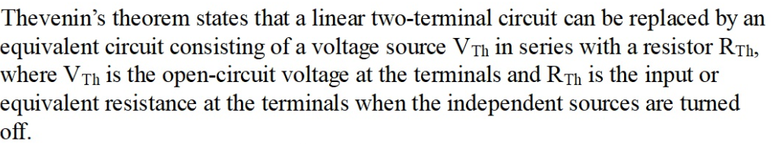
Thevenin’s Theorem
Electrical
network

Slide 6
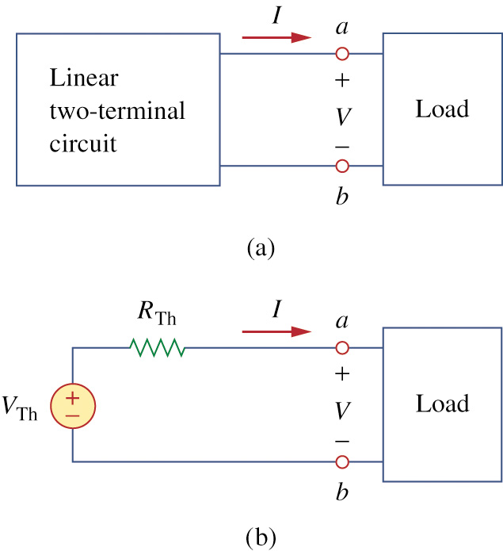
THEVENIN’S THEOREM

Slide 7
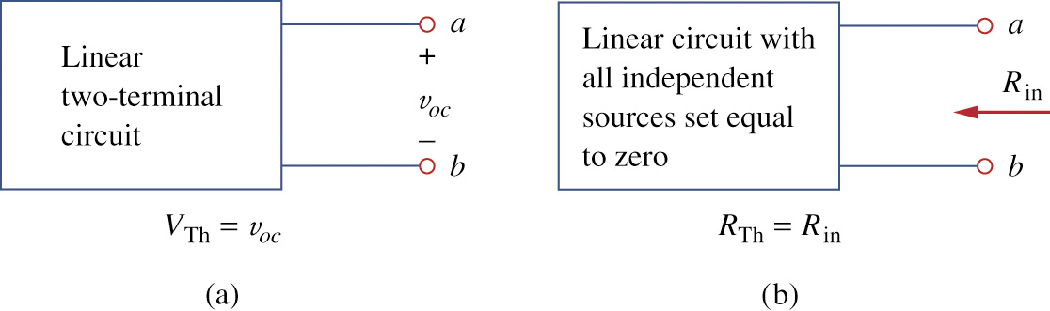
How to Find Thevenin’s Voltage

Slide 8
How to Find Thevenin’s Resistance
Voltage source is replaced by Short circuit
Current source is replaced by Open circuit

Slide 9
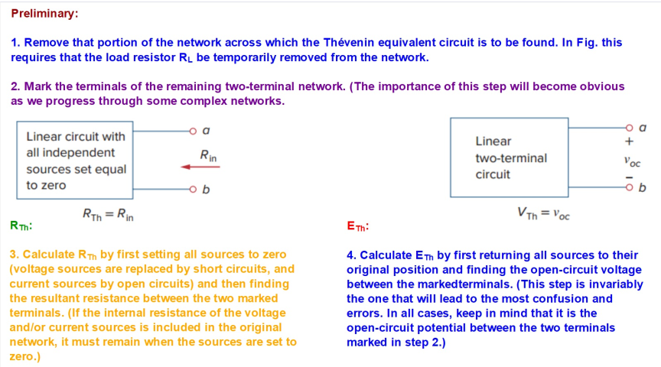

Slide 10
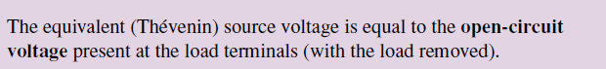

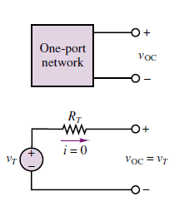
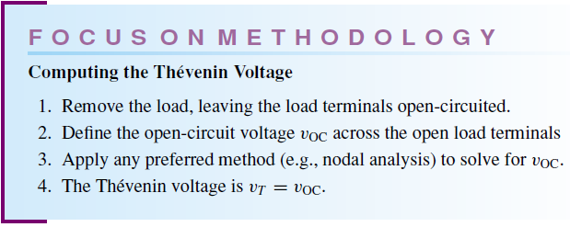
To find thevenin’s voltage

Slide 11
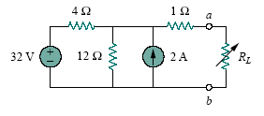
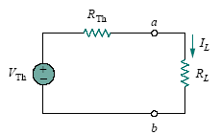
Question: Find the Thevenin’s equivalent circuit of the circuit shown in Figure to the left of the terminals a-b. Then find the current through R_{L} = 6, 16, and 36 .
Solution:
Thevenin’s equivalent circuit

Slide 12
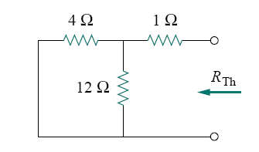
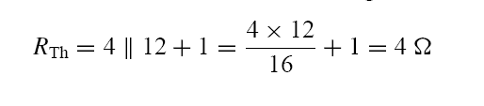
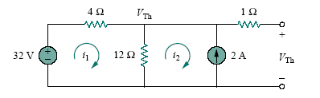
To find R_{Th}
We find R_{Th} by turning off the voltage source (replacing it with a short circuit) and the current source (replacing it with an open circuit). The circuit becomes what is shown in Fig.
To find VTh,

Slide 13


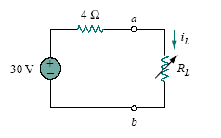

Applying mesh analysis to the two loops, we obtain
The current through R_{L} is
Thevenin equivalent circuit

Slide 14
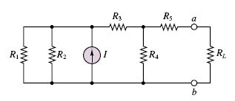
Question

Slide 15

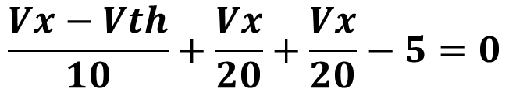
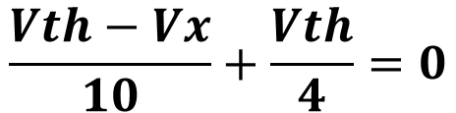
Vx
Vth
Vth calculation
+
Vth
Apply nodal analysis
-
$$\frac{Vth−Vx}{10}+\frac{Vth}{4}=0$$
$$\frac{Vx−Vth}{10}+\frac{Vx}{20}+\frac{Vx}{20}−5=0$$
$$Vth=25 V$$

Slide 16
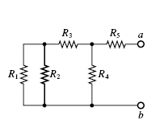
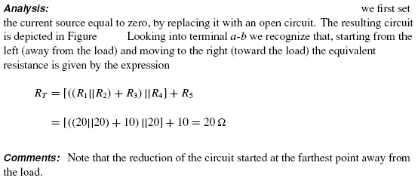
Solution

Slide 17
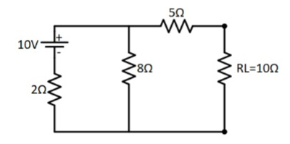
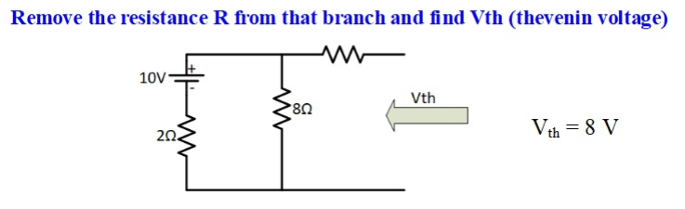
Problem

Slide 18
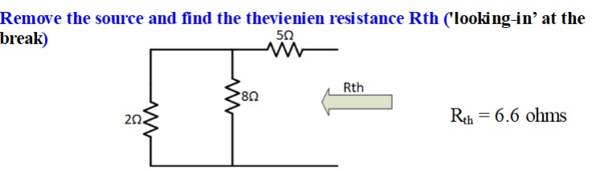
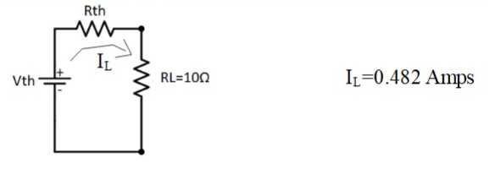
Cont..
Thevenin’s equivalent circuit

Slide 19

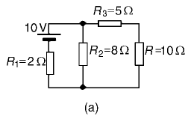

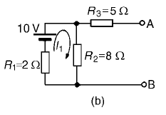

Slide 20
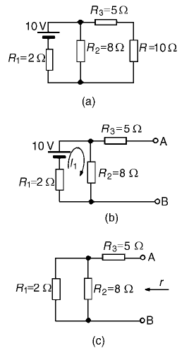
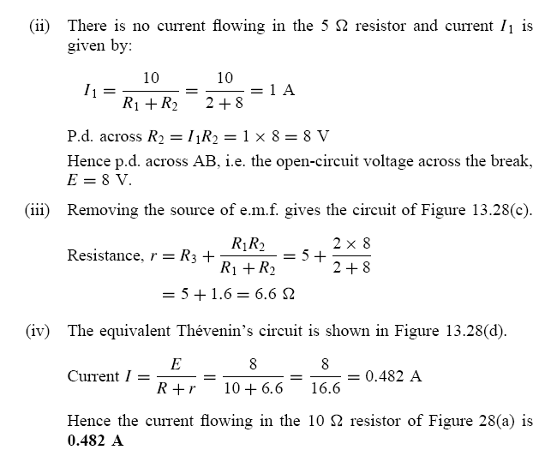
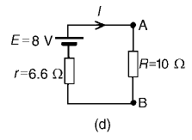

Slide 21
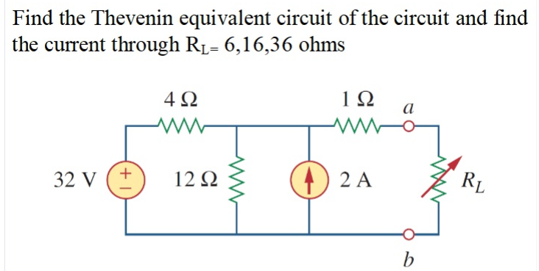
Problem

Slide 22
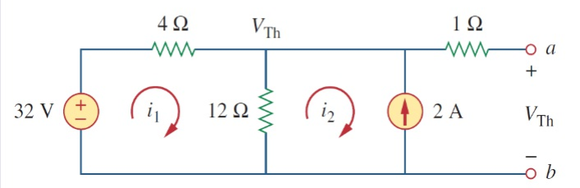
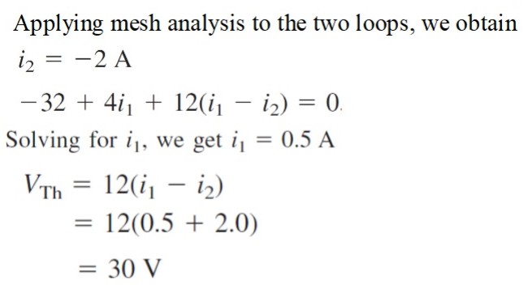
Solution
0 A

Slide 23
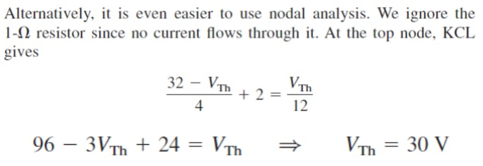
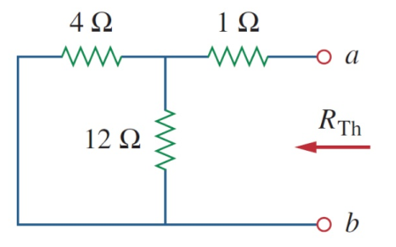
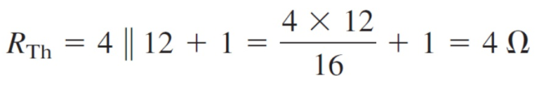
Solution

Slide 24
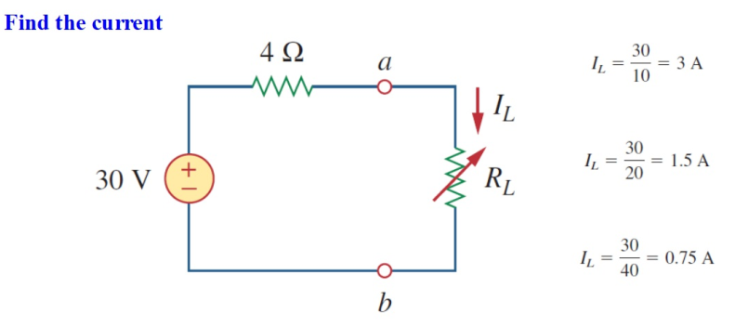
Solution

Slide 25
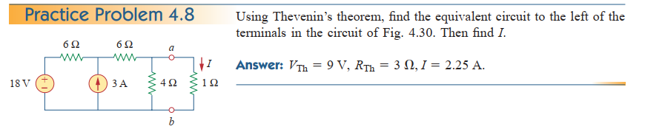
Problem

Slide 26
For the circuit below, find V_{AB} by first finding the Thevenin's
circuit to the left of terminals A-B.

Slide 27
Finding V_{OC} for given circuit

Slide 28
Finding R_{th} for given circuit

Slide 29
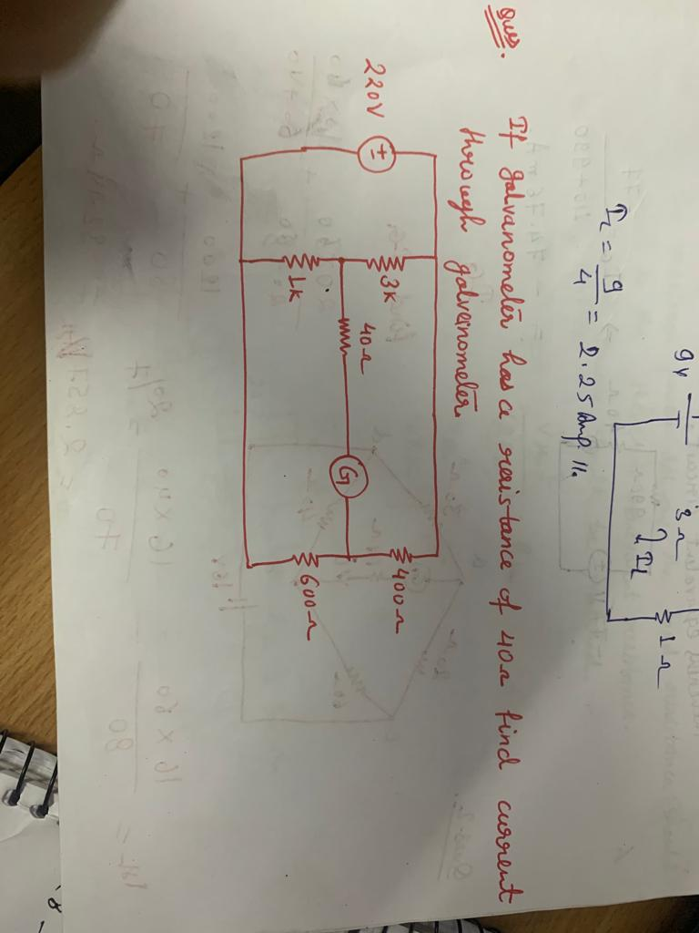

Slide 30
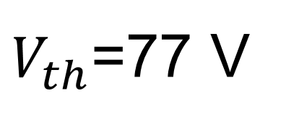
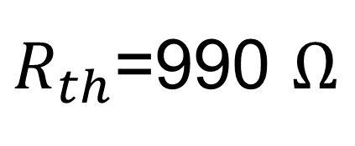
$V_{th}$=77 V
$R_{th}$=990 $Ω$

Slide 31
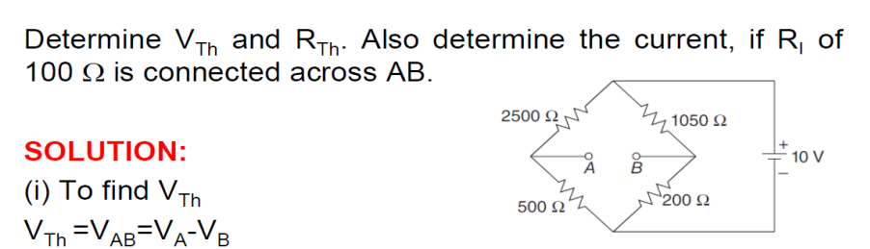
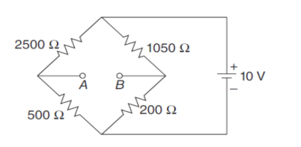

Slide 32
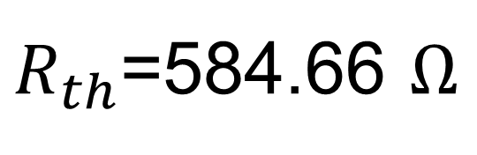
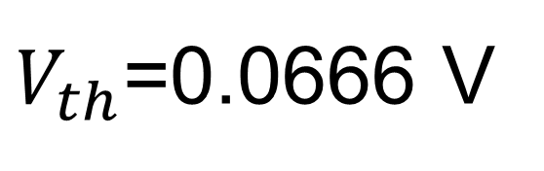
$V_{th}$=0.0666 V
$R_{th}$=584.66 $Ω$

